Slide 1
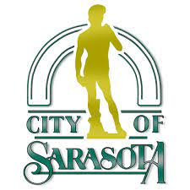
Welcome to the Boulevard of the Arts and 10th Street Complete Streets Open House
Please Sign-In
May 23, 2022

Slide 2
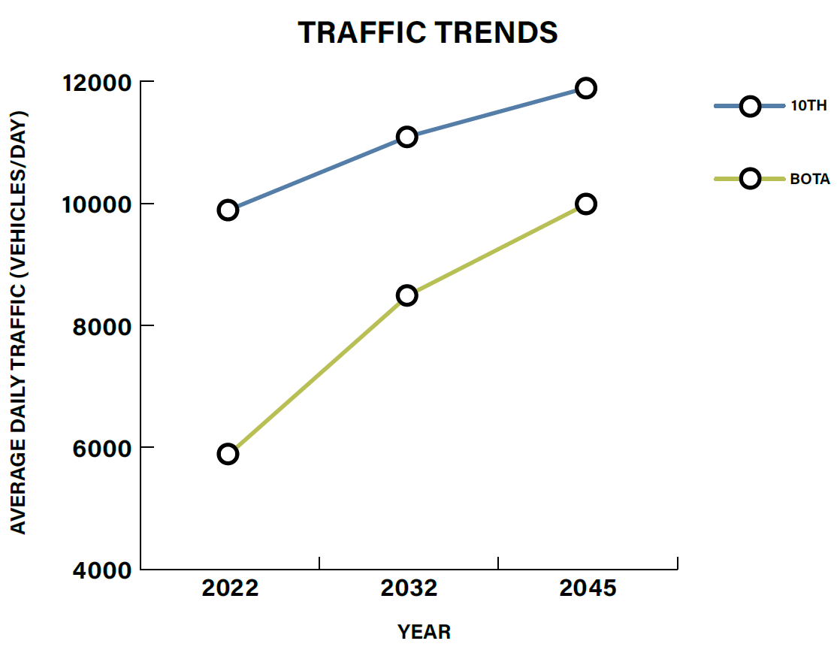
Traffic Data
Traffic was analyzed for three scenarios
Today (2022)
“Near Future” (2032)
“Long Range Future” (2045)
Future conditions are based on historical growth and the regional travel demand model
Per FDOT Guidelines “four-lane roadways with AADT <20,000 are good candidates for lane repurposing”
Conservatively, AADT will peak near 10,000 trips on BoTA and 12,000 trips on 10th in the year 2045
This means that even in 20 years, 10th Street will still have 40% unused vehicular capacity.
AADT means Annual Average Daily Traffic

Slide 3
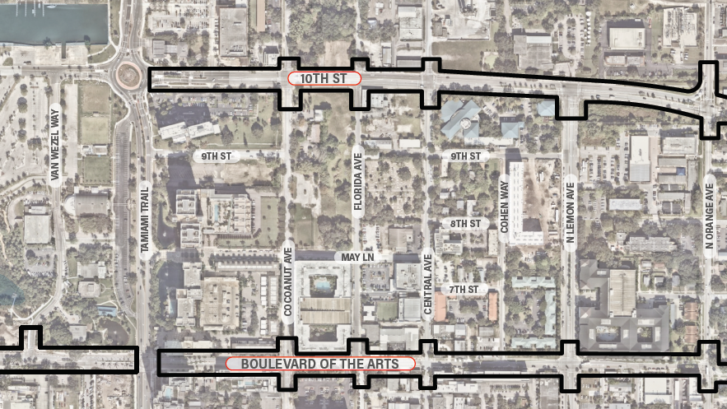
Boulevard of the Arts Online Survey
Online survey to efficiently gather input from the community
Publicly available February 1, 2022 through February 28, 2022
Advertised via City social media and communications channels and the February 22, 2022 edition of the RDA newsletter.
Over the course of the four weeks, 1,084 people participated in the online survey, generating over 18,400 data points and 2,223 comments.

Slide 4
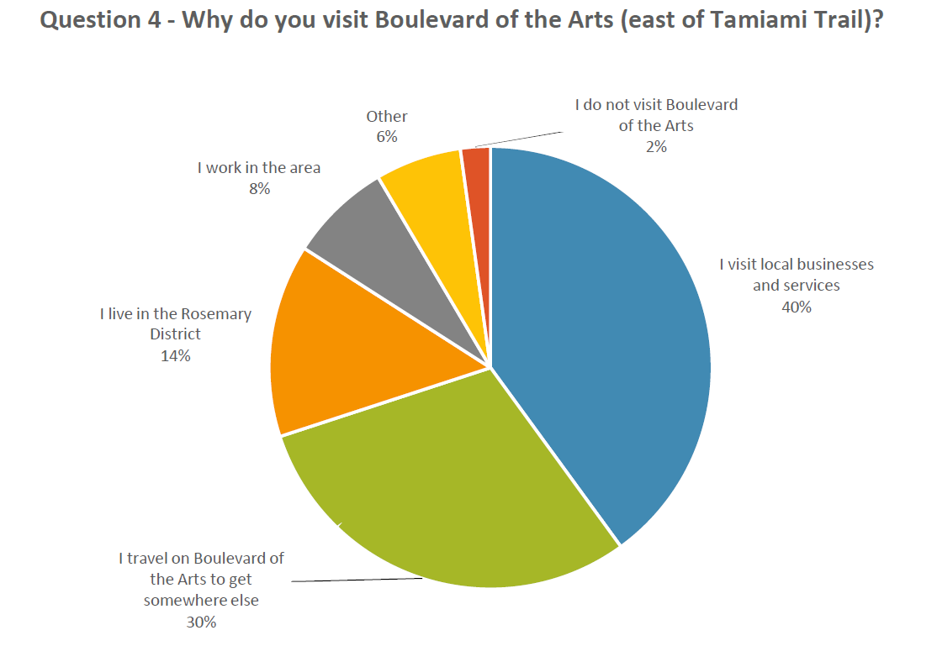
Boulevard of the Arts Survey Results
Incorporating Street Trees
Landscaping and Green Space
Flexible spaces for pedestrian activity
Sidewalk Café space
Wider Sidewalks
Additional Parking Spaces

Slide 5
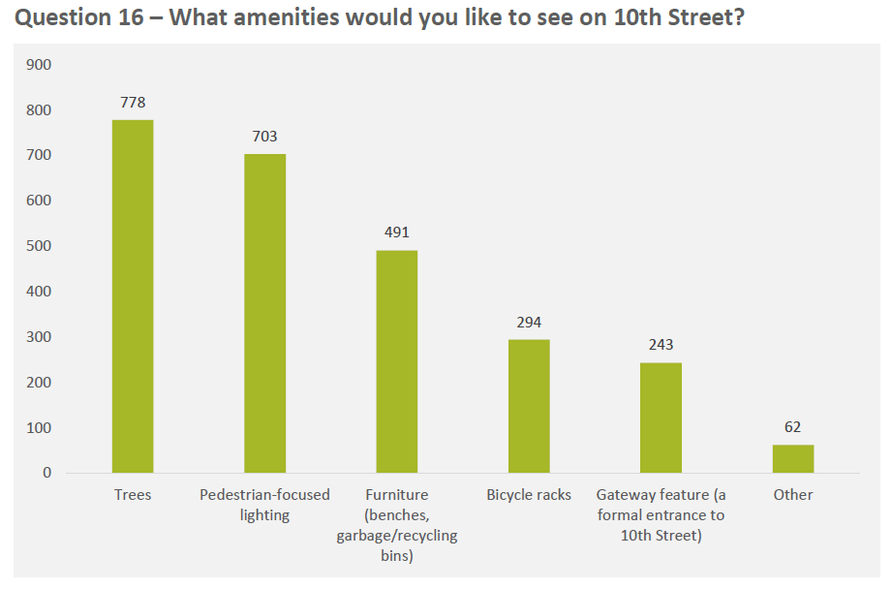
10th Street Survey Results
Incorporating Street Trees
Landscaping and Green Space
Balancing support for local businesses and economic development with traffic flow
A formal gateway to The Bay
Multimodal accommodations including protected bicycle lanes
Pedestrian focused lighting

Slide 6
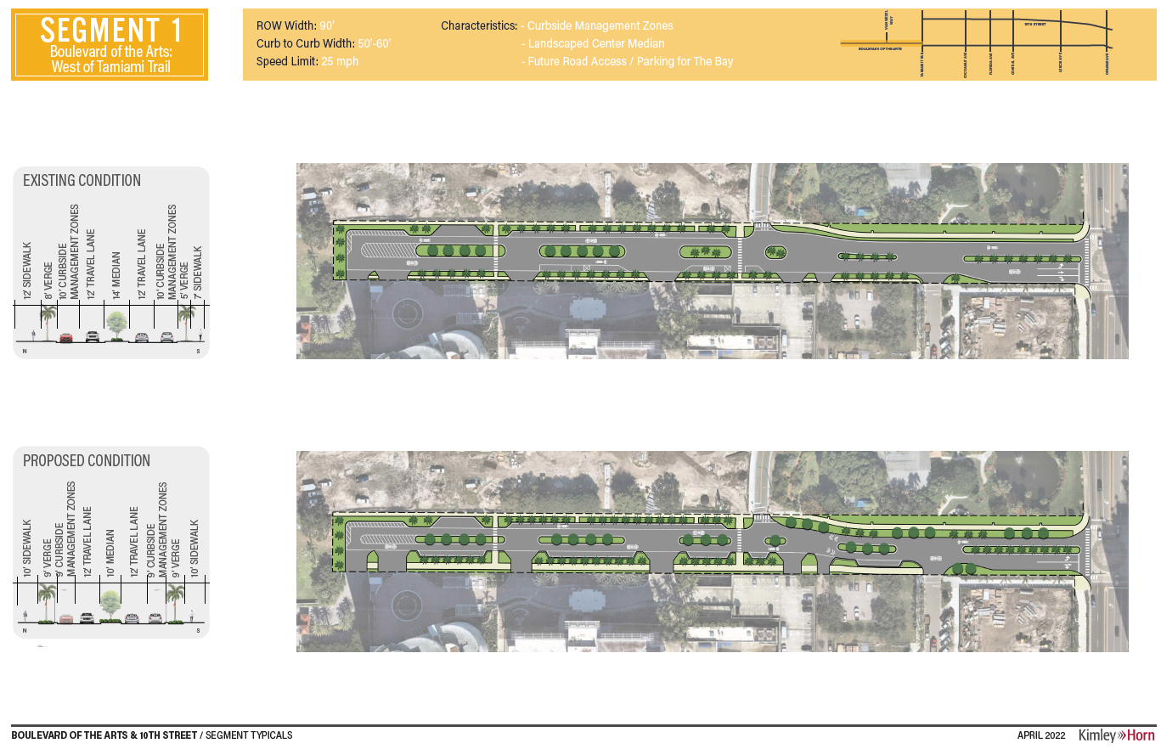

Slide 10
